Slide 1
SCM Updates [FP2020]
Supply Chain Management (SCM) Models
17 October 2014
BkkbN/UNFPA

Slide 2
Supply Chain Management Model
Model-A
Model-B
Model-C
Strengthen current BkkbN's capacity and improve on existing SCM activities
Strengthen current BkkbN's capacity in coordination with MOH at the district level
Third party (3PL) contract to support BkkbN's SCM activities

Slide 3
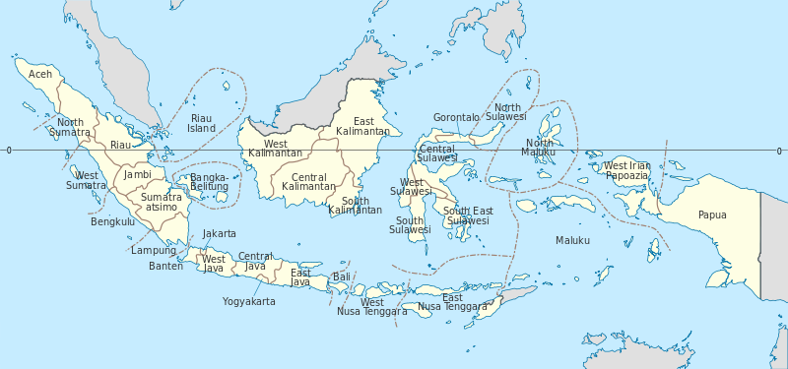
MAP of Indonesia with 34 Provinces
Pilot Intervention

Slide 4
Goal and Objectives of Piloting SCM Models
BkkbN
MOH
BPJS
Serve the People
Make Year-Round Availability of Contraceptives
Support National FP and RH Programs
Support National BPJS and JKN Programs
Better Coordination at all Levels

Slide 5
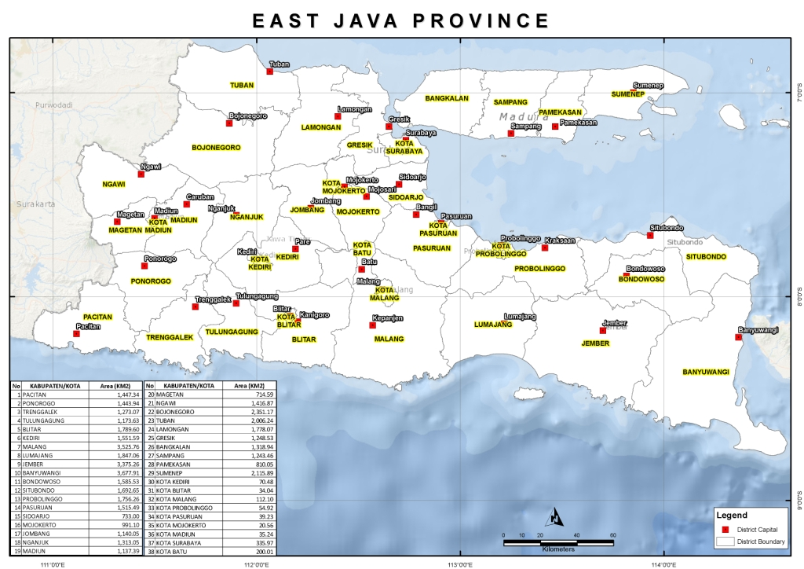
B
A
C

Slide 6
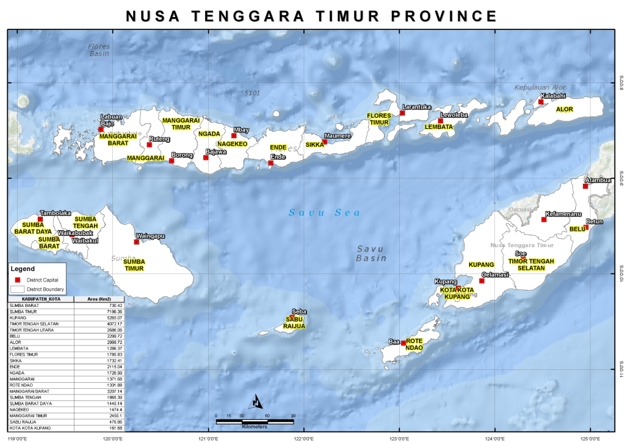
C
B
A
B
A
C

Slide 7
Pilot Districts
NTT Province
East Java Province
Pilot Districts
Control District
Pilot Districts
Control District
Kota Kupang, Kabupaten Kupang (Model A)
Manggarai or Belu
Lamongan (Model A)
Tuban
Sikka, Sumba Barat (Model B)
Flores Timur & Alor
Pamekasan (Model B)
Sampang
Sabu Raijua, Manggarai Barat (Model C)
Sumbah Tengah or Manggarai Timur
Banyuwangi
(Model C)
Pasuruan

Slide 8
SCM Training Curriculum
Existing BkkbN’s SCM Manual
SOP of SCM Models
Additional Slides/Materials
Revised/Improved SCM Model Training Curriculum for District and Puskesmas
Partici-pants Hand Book
Refere-nce Manual
Trainer’s Guide
International Standards
Competency based

Slide 9
SCM Model Training for Districts (3-Days) (Sessions and Time Allocated in minutes)
Pre-Test
Competency based
Post-Test
Adult Learning Method
Training Evaluation

Slide 10
Summary: SCM TOT and Training Session Plan
SN. | Description | Main Topic Covered | Time Duration
1. | Opening Session | Registration; Introduction by participants; Objectives and Goal; Remarks by Guest; Training Rules, Selection of Reporters and Officers of a day from participants; Pre-Test | 60 min
2. | Introduction Session | Logistics Cycles; Six-Rights; Definitions; SCM Model Design; Core Activities | 105 min
3. | Inventory Management Session | Min-Max Level and EOP; Contraceptive Flow Chart; EXERCISES; Key Procedures at different levels | 150 min
4. | SCM/Logistics Indicator Session | Performance Indicators, Process Indicators, How they are measured | 60 min
5. | Storage and Warehousing Session | General principle, Useful signs in cartoons, 13-points standard storage guidelines, Disposal of expired and un-usable | 105 min
6. | Distribution and Transportation Session | Pull and Push distribution, distribution system at different levels | 45 min
7. | Recording and Reporting Session (LMIS) | Forms used for record keeping, Reporting (Practice filling up 21 Forms), Flow of Reports | 195 min
8. | QA, Supervision, M & E Session | Quality Assurance at various stages (procurement, storage, distribution, transportation);Monitoring at different levels; monitoring logistics indicators; Evaluation at different levels | 120 min
9. | Closing Session | Admin/Finance activities, Post-Test, Training Evaluation Form, Closing Remarks | 105 min

Slide 11
Implementation and Training Plan
District
Curriculums
Standard Operating Procedure for Model A, B and C
Receiving, Storage, and Distribution of Contraceptives and Non-Contraceptives for National FP Program
Other Training Materials (additional Slides)
Center
Province
3-Days Training Program at District
(SKPDKB, Puskesmas,
Dinkes, and BPJS)
3-Days TOT/Training at Province (NTT) (MOH, BkkbN, PTPOS, District, BPJS)
A
3-Days TOT (Training of Trainers) at BkkbN
Participants
BkkbN-4
MOH – 2
Province – 2
PT POS – 2
BPJS (observer)
3-Days Training Program at District
(SKPDKB, DinKes,
Puskemas, BPJS)
B
3-Days TOT/Training at Province (East Java) (MOH, BkkbN, PTPOS, District, BPJS)
3-Days Training Program at District
(SKPDKB, PT-POS, Puskesmas,
DinKes, BPJS)
C

Slide 12
Timeline for Piloting SCM Model Activities
Draft/revised SCM Training Curriculum for Model A, B and C
Collect baseline performance indicators
Evaluation of Pilot Districts
Close Supervision and Monitoring
Aug
Sep
Oct
Nov
Dec
Jan
Feb
Mar
Apr
May
2014
2015
Mid-Term Review
Client Exit Interview
Evaluation Report and Dissemination
TOT/Training in District for Piloting

Slide 13
Twelve (12) Training Points
Participants
Total Trainees | 253
Total Trainers | 37
Total Observers | 61
Total | 351
TOT in Center
Orientation/TOT in East Java
Orientation/TOT in NTT
Training in Lamongan [A]
Training in Kota Kupang [A]
Training in Kabupaten Kupang [A]
Training in Pamekasan [B]
Training in Sikka [B]
Training in Sumba Barat [B]
Training in Banyuwangi [C]
Training in Sabu Raijua [C]
Training in Manggarai Barat [C]

Slide 14
Thank You!

